Slide 1
SENSOR & INSTRUMENTATION KOE 044 Unit 1

Slide 2
Sensor and Instrumentation
Pre-requisite for Course- Basic Electrical Engineering
Course Outcomes-
CO1 | Apply the use of sensors for measurement of displacement, force and pressure | K3
CO2 | Employ commonly used sensors in industry for measurement of temperature, position, accelerometer, vibration sensor, flow and level | K3
CO3 | Demonstrate the use of virtual instrumentation in automatic industries | K2
CO4 | Identify and use data ac uisition methods | K3
CO5 | Comprehend intelligent instrumentation in industrial automation | K2

Slide 3
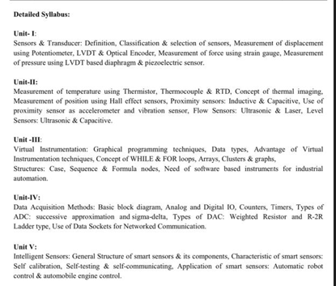
University Syllabus

Slide 4
Contents:
Measurement System
Introduction & Definition of Sensor & Transducer
Selection & Classification of Sensors
Measurement of Displacement Using Potentiometer
LVDT
Optical Encoder,
Measurement of Force Using Strain Gauge
Measurement of Pressure Using LVDT based Diaphragm
Measurement of Pressure Using Piezoelectric Sensor

Slide 5
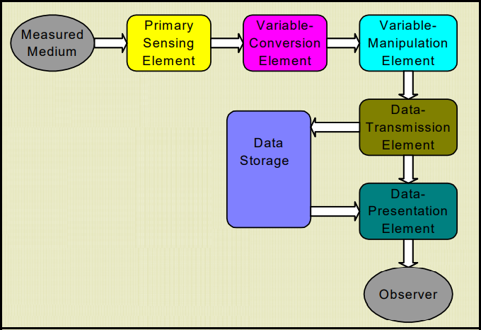
Measurement System:
The term measurement system includes all components in chain of hardware and software that leads from the measured variable to processing of the data

Slide 6
Introduction: Sensor, Actuators and Transducers
A sensor is a device that provides usable output in response to a specified quantity which is measured.
In simple terms, a sensor is a device that detects changes and events in a physical stimulus and provides a corresponding output signal that can be measured and/or recorded.
Actuators are devices that work opposite to sensors. A sensor converts a physical event into an electrical signal, whereas an actuator converts electrical signal into a physical event.
Transducers are the devices that convert energy in one form into another form. Generally the energy is in the form of a signal. Transducer is a term collectively used for both sensors and actuators.

Slide 7
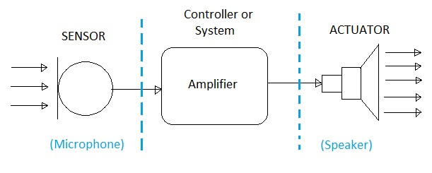
Introduction: Sensor, Actuators and Transducers

Slide 8
Introduction: Criteria to Choose a Sensor
Type of Sensing: The parameter that is being sensed like temperature or pressure.
Operating Principle: The principle of operation of the sensor.
Power Consumption: The power consumed by the sensor will play an important role in defining the total power of the system.
Accuracy: The accuracy of the sensor is a key factor in selecting a sensor.
Environmental Conditions: The conditions in which the sensor is being used will be a factor in choosing the quality of a sensor.

Slide 9
Introduction: Criteria to Choose a Sensor
Cost: Depending on the cost of application, a low cost sensor or high cost sensor can be used.
Resolution and Range: The smallest value that can be sensed and the limit of measurement are important.
Calibration and Repeatability: Change of values with time and ability to repeat measurements under similar conditions.

Slide 10
Introduction: Basic Requirements of a Sensor or Transducer
Range: It indicates the limits of the input in which it can vary. In case of temperature measurement, a thermocouple can have a range of 25 – 250 degree C.
Accuracy: It is the degree of exactness between actual measurement and true value. Accuracy is expressed as percentage of full range output.
Sensitivity: Sensitivity is a relationship between input physical signal and output electrical signal. It is the ratio of change in output of the sensor to unit change in input value that causes change in output.
Stability: It is the ability of the sensor to produce the same output for constant input over a period of time.
Repeatability: It is the ability of the sensor to produce same output for different applications with same input value.

Slide 11
Introduction: Basic Requirements of a Sensor or Transducer
Response Time: It is the speed of change in output on a stepwise change in input.
Linearity: It is specified in terms of percentage of nonlinearity. Nonlinearity is an indication of deviation of curve of actual measurement from the curve of ideal measurement.
Ruggedness: It is a measure of the durability when the sensor is used under extreme operating conditions.
Hysteresis: The hysteresis is defined as the maximum difference in output at any measurable value within the sensor’s specified range when approaching the point first with increasing and then with decreasing the input parameter. Hysteresis is a characteristic that a transducer has in being unable to repeat its functionality faithfully when used in the opposite direction of operation.

Slide 12
Introduction: Classification of Sensors
Acoustic: Wave, spectrum and wave velocity.
Electric: Current, charge, potential, electric field, permittivity and conductivity.
Magnetic: Magnetic field, magnetic flux and permeability.
Thermal: Temperature, specific heat and thermal conductivity.
Mechanical: Position, acceleration, force, pressure, stress, strain, mass, density, momentum, torque, shape, orientation, roughness, stiffness, compliance, crystallinity and structural.
Optical: Wave, wave velocity, refractive index, reflectivity, absorption and emissivity

Slide 13
Introduction: Types of Sensors
Displacement, Position and Proximity Sensors.
Temperature Sensors
Resistive Element or Potentiometer
Capacitive Elements
Strain Gauged Element
Inductive Proximity Sensors
Eddy Current Proximity Sensors
Differential Transformers
Optical Encoders
Hall Effect Sensors
Pneumatic Sensors
Proximity Switches
Rotary Encoders
Thermistors
Thermocouple
Bimetallic Strips
Resistance Temperature Detectors
Thermostat
Light Sensors
Photo Diode
Phototransistor
Light Dependent Resistor

Slide 14
Introduction: Types of Sensors
Velocity and Motion
Liquid Flow and Level
Turbine Meter
Orifice Plate and Venturi Tube
Pyroelectric Sensors
Tachogenerator
Incremental encoder
IR Sensor
Infrared Transmitter and Receiver Pair
Fluid Pressure
Force
Diaphragm Pressure Gauge
Tactile Sensor
Piezoelectric Sensors
Capsules, Bellows, Pressure Tubes
Strain Gauge
Load Cell
Touch Sensors
Resistive Touch Sensor
Capacitive Touch Sensors

Slide 15
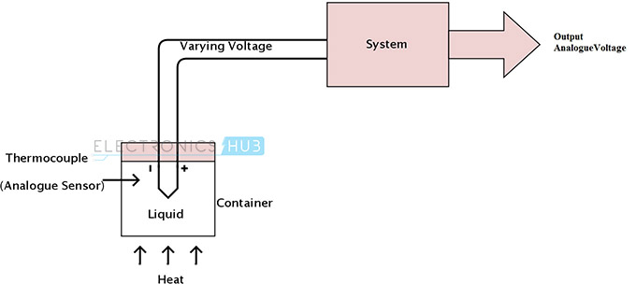
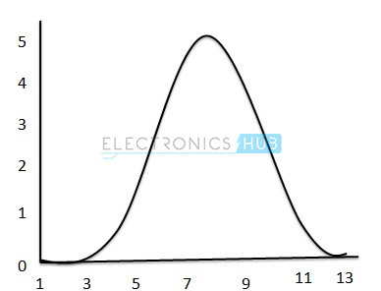
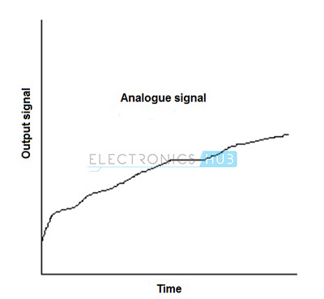
Introduction: Analog Sensors
An analog sensor produces continuously varying output signals over a range of values.

